Slide 1

.NET Performance

Slide 2
Who are we?
Rob Liekens
Marc Wouters
Ordina Consultant
Ordina Consultant
Working @ Digipolis Antwerp
Team lead
.NET Development
DevOps
Technical analysis
Working @ Digipolis Antwerp
.Net Development
Angular/Vue Development
Innovation participant
AI enthousiast

Slide 3
Agenda
What is optimization?
Value vs reference types
Boxing / Unboxing
Garbage collection
Best practices
LINQ
Threading
Profiling

Slide 4
What is optimization?

Slide 5
Application optimization
Offline processing applications
Maximize throughput
Optimize for 100% load
GUI applications
Minimize latency
Minimize memory utilization

Slide 6
Memory hierarchy
Medium | Size | Access time
Virtual memory: HDD | 2GB - …GB typical size | 3-15 ms
Virtual memory: SSD | 2GB typical size | 150 µs
Physical memory | 8GB typical size | 100 ns
L3 cache | 16 MB | 18 ns
L2 cache | 4 MB | 7 ns
L1 cache | 768 KB | 0.5 ns

Slide 7

Mobile application optimization
Memory constrained
Sacrifice speed for memory
Less caching
Limit threads
Limit assets
Less complicated UI

Slide 8
Value vs reference types

Slide 9
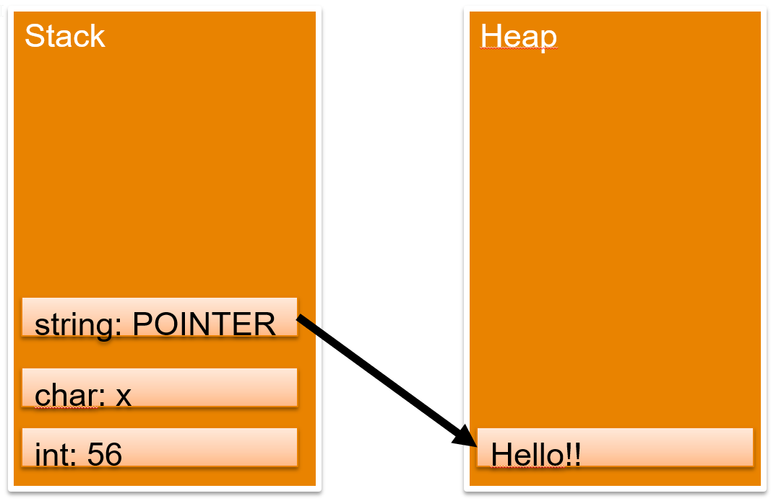
Value vs reference types
Value types store their value directly on the stack
Reference types store a reference (on the stack) to a location on the heap

Slide 10
Stack vs heap
 | Stack | Heap
Memory | Limited & static | Unlimited & dynamic
Performance | Very fast | ‘Slower’
Memory management | Auto | Manual / GC (garbage collection)

Slide 11
Common Value Types
BCL Type | C# alias | Bytes | Range
System.SByte | sbyte | 1 | -128 to 127 (2⁸)
System.Byte | byte | 1 | 0 to 255 (2⁸)
System.Int16 | short | 2 | -32768 to 32767 (4⁸)
System.Int32 | int | 4 | -2147483648 to 2147483647 (16⁸)
System.UInt32 | uint | 4 | 0 to 4294967296 (16⁸)
System.Int64 | long | 8 | - to + (256⁸)
System.Single | float | 4 | - to + (16⁸)
System.Double | double | 8 | - to + (16777216⁸)
System.Decimal | decimal | 16 | - to + (4294967296⁸)

Slide 12
Common Value Types
BCL Type | C# alias | Bytes
System.Char | char | 2
System.Boolean | bool | 1
System.DateTime | DateTime | 8
System.Int32 | int | 4
System.UInt32 | uint | 4
System.Int64 | long | 8
System.Single | float | 4
System.Double | double | 8
System.Decimal | decimal | 16

Slide 13
Reference Types
BCL Type | Use for
System.Object | The most general Type in .NET, every object inherits from this
System.String | Text data
System.Array | Arrays of data, base class for all arrays
System.IO.Stream | Buffer for file, device and network input/output (I/O). Stream class is abstract
System.Exception | Handeling exceptions, more specific exceptions inherit from this one
System.Text.StringBuilder | Dynamic text data

Slide 14
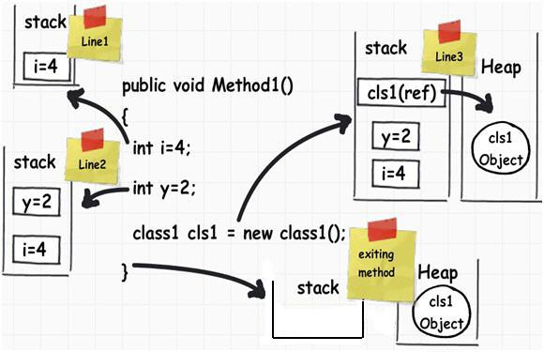
Putting it al together

Slide 15
Boxing / Unboxing

Slide 16

Boxing / Unboxing
Boxing
Converting a value type to a reference type
Unboxing
Converting a reference type to a value type

Slide 17


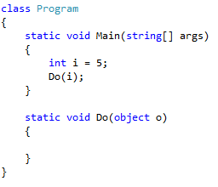
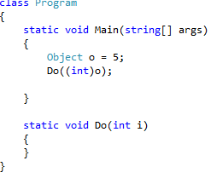
Boxing / Unboxing
Boxing
Unboxing

Slide 18
Boxing / Unboxing
Boxing and unboxing causes a lot of overhead
Up to 5x slower!
3-4x more memory!
Try to avoid it
Use generics
Define appropriate overloads for different parameter types
Structs:
Override ToString, Equals and GetHash methods of System.Object when defining structs => Boxing occurs when calling virtual methods of System.Object
Avoid constructor overloading => instance would be allocated on the heap

Slide 19
Garbage collection

Slide 20
Garbage collection
Remember Value / Reference types?
Value types
Stack
Reference
Heap
Stack is self-maintaining
meaning that it basically takes care of its own memory management
The Heap has to worry about Garbage collection (GC)
which deals with how to keep the Heap clean

Slide 21
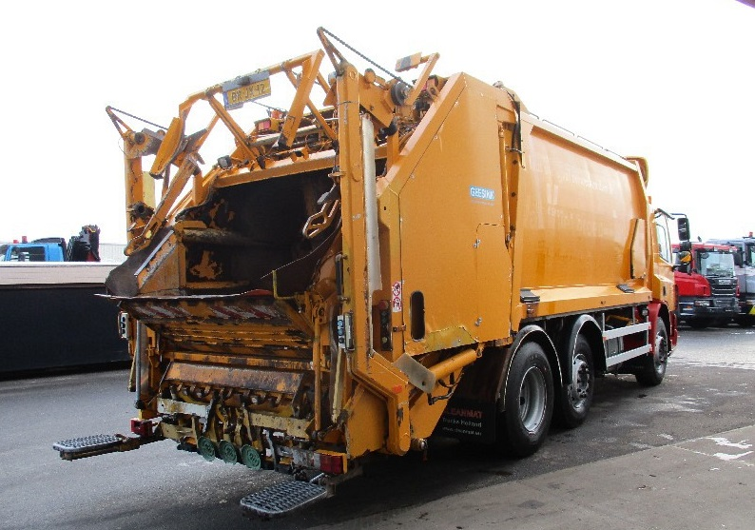
Garbage collection
How does the memory get cleaned up?
Garbage collection
No need to deallocate memory manually
There’s no delete keyword
Objects are stored in the managed heap
Get destroyed automatically at some point in the future
We can influence the way objects get destroyed when they are GC’ed
Finalize
Dispose

Slide 22

Garbage collection
When we instantiate new reference types, the .NET runtime will create them on the heap
Allocate a class instance onto the managed heap using the new keyword and forget about it
Garbage collector will destroy it when it’s no longer needed
How does it know that?
When the object is unreachable from other code

Slide 23
Garbage collection
No guarantee on when GC will run
Only guarantee is that it will be destroyed at some point
No memory leaks or manual deletion of objects from memory
When we set a reference to null, the reference no longer points to an object in memory
Doesn’t trigger GC
Object might be GC’ed since the reference is deleted though

Slide 24
Garbage collection
Objects are assigned a generation
The longer an object has existed on the heap, the more likely it is to stay there
Main window of an application
Recent objects might have a local scope only
Unreachable quicker
Available generations
Generation 0: Identifies a newly allocated object that has never been marked for collection.
Generation 1: Identifies an object that has survived a garbage collection
Generation 2: Identifies an object that has survived more than one sweep of the garbage collector

Slide 25
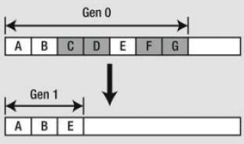
Garbage collection
GC will first inspect generation 0
Enough memory is available
All remaining objects will become generation 1
If not, generation 1 will be tested for reachability
Survivors will become generation 2
No higher level exists

Slide 26
Garbage collection
Finalizers only run when GC runs
Might be too late for important objects such as DB connections
Might be interesting to release them asap
Implement the IDisposable interface
Exposes Dispose method
Can be called by the user of the object when the object is about to go out of scope
Doesn’t have to wait to be GC’ed
No separate threads need to be started
Has nothing to do with unmanaged resources
GC has no clue about the Dispose method

Slide 27
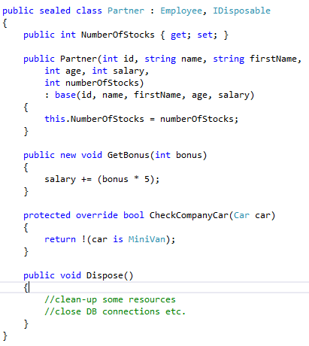
Garbage collection

Slide 28
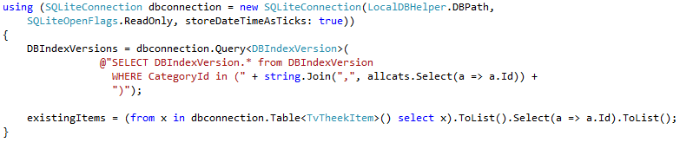
Garbage collection
Using
Objects implementing the IDisposable interface can be used with the using keyword
At end of using block dbconnection will be disposed
Cleaning up all open resources
Very important with DB connections
Even when exception occurs inside using, dispose will be called

Slide 29
Best practices

Slide 30

Basic optimization
Const vs readonly
Static vs local fields
Class vs struct
Use the best type for the job
Caching

Slide 31
StringBuilder
Strings
Are immutable
Saved on heap
Copies string on change
StringBuilder
Dynamic object
Does not create a new string
Allows expansion of the number of characters by expanding allocated memory

Slide 32
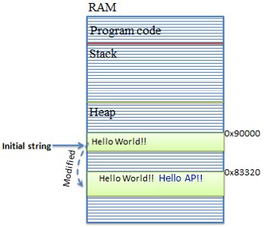
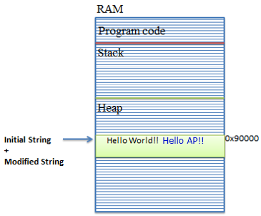
StringBuilder
String concatenation
StringBuilder

Slide 33
StringBuilder
Cache your StringBuilder when possible
Watch out for .Equals()
Same Capacity
Same MaxCapacity
Same characters
Check equality by iterating over characters

Slide 34
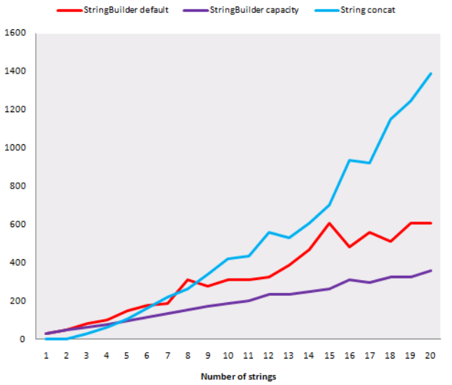
StringBuilder
Not always faster than concatenation!

Slide 35
Collection optimization
ArrayList
Boxing/unboxing
List<T>
Generic (strongly typed) => no boxing/unboxing
Creating list with defined size is faster
Adding/removing at begin or middle is slow
Adding/removing at end is relatively fast
Search will iterate over items till found
Very fast at accessing items by an index
Not advisable when accessing items by criteria

Slide 36
Collection optimization
Dictionary<TKey, TValue>
Fast lookups by key even for large lists
HashSet<T>
Unique values, no keys
Super fast lookups
{ 1, 2, 3 } == { 3, 2, 1 }
Stack<T>
LIFO (Last-In-First-Out)
Queue<T>
FIFO (First-In-First-Out)

Slide 37
Method optimization
Parameters
Number of parameters
Class instead of struct
Use local variables instead of class fields
Return > out
Multiple return values
Class
Out
KeyValuePair
Tuple

Slide 38
Method optimization
Aggressive inlining
Copy of method body
Not for frequently used methods
Call depth
Method call adds stack frame
Call sequential instead of nested methods if possible
Difficult to inline recursive methods => inline first call

Slide 39
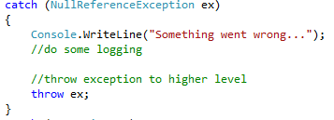
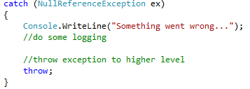
Throw ex vs throw
Throw ex
Resets the stacktrace => your errors would appear to originate from HandleException
Throw
StackTrace not adjusted
Original offender is preserved
Reuse exception = less overhead

Slide 40

https://github.com/tiebird/Ordina-performance

Slide 41
LINQ

Slide 42
LINQ
LINQ was introduced with .NET 3.5
Stands for Language-Integrated Query Language
Look and feel of LINQ queries is similar to SQL statements
Query expressions can be used to interact with numerous types of data
Exists in many flavors
Can be written in query or method syntax

Slide 43
LINQ
LINQ flavors
LINQ to Objects
This term refers to the act of applying LINQ queries to arrays and collections.
LINQ to XML
This term refers to the act of using LINQ to manipulate and query XML documents.
LINQ to DataSet
This term refers to the act of applying LINQ queries to ADO.NET DataSet objects.
LINQ to Entities
This aspect of LINQ allows you to make use of LINQ queries within the ADO.NET Entity Framework (EF) API.
Parallel LINQ(a.k.a. PLINQ)
This allows for parallel processing of data returned from a LINQ query

Slide 44
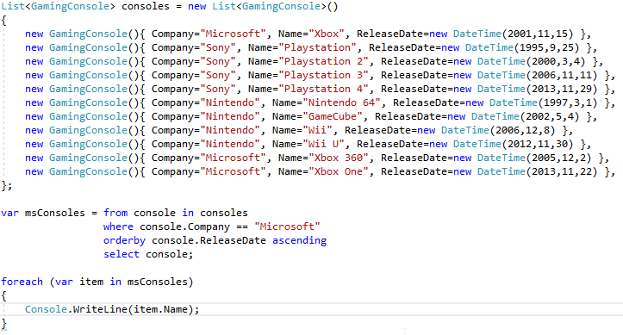

LINQ
LINQ query syntax
LINQ method syntax

Slide 45
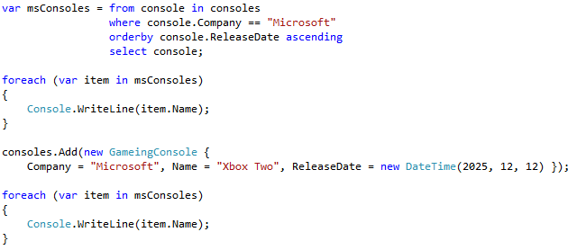
LINQ
Deferred Execution
Allows us to create several queries and still get back only the latest results
Aren’t cached somewhere, the list can change and so will the results
Query is evaluated here
Query is evaluated here again

Slide 46

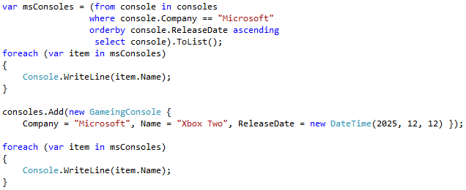
LINQ
Immediate Execution
Xbox Two will not be in the result
Query is evaluated here

Slide 47
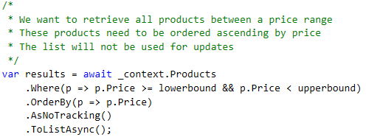
LINQ to Entities optimization
Select only necessary data
Order your queries carefully
Turn off object tracking when only reading => .AsNoTracking()

Slide 48
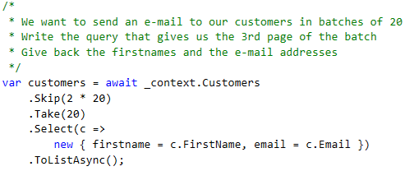
LINQ to Entities optimization
Page your data when possible
Use projections => anonymous objects

Slide 49
LINQ to Entities optimization
Action | When
Eager loading | If there is a HIGH chance data will be requested shortly
Lazy loading | When there is a LOW chance data will be requested shortly
Precompiled query | Queries that are used frequently
Debug your queries | If query contains complex logic
(Disable optimistic concurrency) | When there is no issue with only keeping the last saved item

Slide 50
Threading

Slide 51



Threading
Parallel
Concurrent
Async

Slide 52
Threading
Long during tasks should be offloaded to another thread
Avoid UI freeze
Threads are quite hard to implement
Visual Studio 2012 introduces simplified approach
Async programming
Leverages asynchronous support in the .NET Framework 4.5 and the Windows Runtime
Compiler does the difficult work
Doesn’t start new threads itself
Just of way of controlling continuations

Slide 53
Threading
Potential long running methods have been made async in .NET4.5
WebAccess
HttpClient, …
Accessing files
StorageFile, StreamWriter, …
Working with images
MediaCapture, BitmapEncoder, …
WCF programming

Slide 54
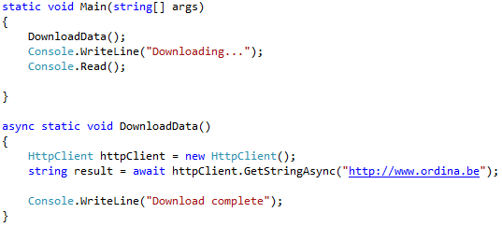
Threading
HttpClient
public async Task<string> GetStringAsync(string uri);
GetStringAsync returns a Task<string>
A string will be returned when we await the task
We can await the method

Slide 55
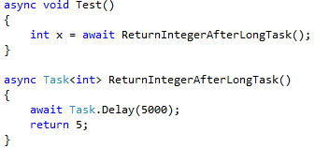
Threading
Async void
Method contains one or more long running taks
Method can’t be awaited!
Void
Fire and forget
Return values have to be packed in a Task
Async Task<int>
Result of the long running method is an integer
Await will automatically ‘unpack’ the integer
In the method just return the value (not Task)

Slide 56

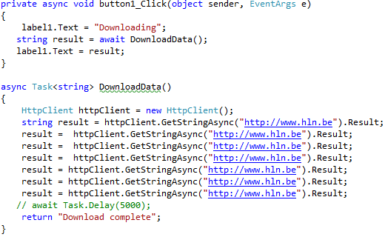
Threading
Task<> also has a Result property
Blocking call! => UI will freeze

Slide 57
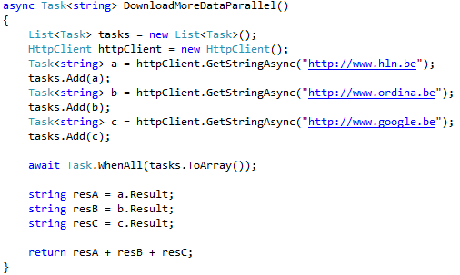
Threading
Multiple long during tasks that don’t interfere with each other can be launched simultaneously
Use Task.WhenAll for all the tasks to complete

Slide 58
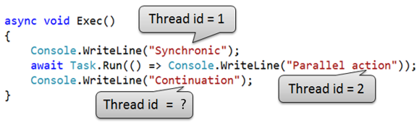
Threading
Async will not start multiple threads by itself
Awaiting the Task.Run method does execute the code on an other thread

Slide 59
Profiling

Slide 60
What is profiling
Wikipedia: In software engineering, profiling ("program profiling", "software profiling") is a form of dynamic program analysis that measures, for example, the space (memory) or time complexity of a program, the usage of particular instructions, or the frequency and duration of function calls. Most commonly, profiling information serves to aid program optimization.

Slide 61
When to profile
After writing a performance critical service
AND after changing a performance critical service
Code that will be reused often
Includes loops!
When debugging
If memory or performance issues already surfaced

Slide 62

Measurement tools
Sampling profilers
Snapshots
Controllable overhead by reducing sampling rate
Support attach
Imprecise
Instrumentation profilers
Code injection
Accurate timing
More overhead
Require restart

Slide 63
Most used measurements
CPU
Utilization
CPU cycles/ticks or wall-clock time
Memory
Utilization
% load
Data access
Utilization
Bandwidth
Latency

Slide 64
Profiling software
Free
Visual Studio Diagnostic Tools
Basic memory and CPU profiling for 1 process
Perfview
Global memory and CPU profiling
SQL Server Profiler
SQL execution plan profiling
Part of the Microsoft SQL Server Management Studio
Paid
JetBrains dotTrace => free student license
RedGate ANTS

Slide 65
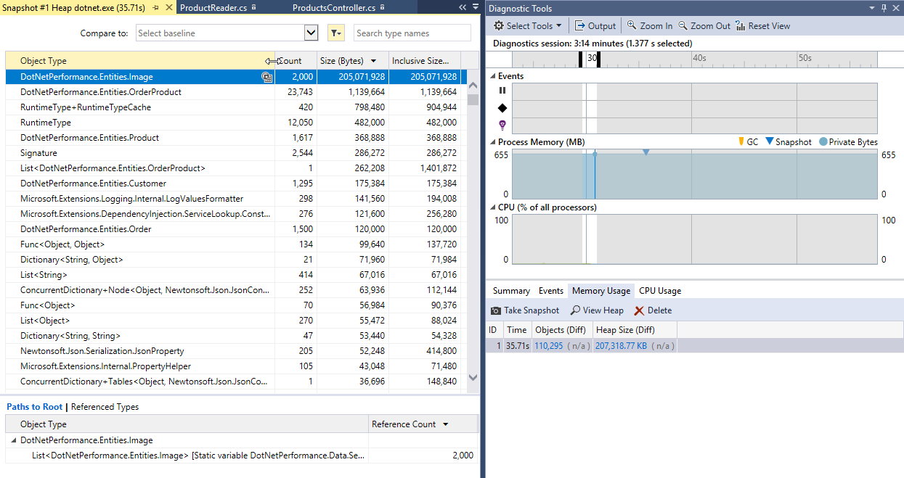
Visual Studio Diagnostic Tools

Slide 66
https://github.com/tiebird/Ordina-performance

Slide 67

Contact:
rob.liekens@ordina.be
marc.wouters@ordina.be

